Slide 1

Bay 2, Stage 2 Weak Already? Course Designer: Loke Tan
Weak Already? is an 11 round, 55 point Comstock Medium Course. There are 3 IPSC targets and 5 steel targets. The best two hits per target will score. Steel must fall to score. The start signal is audible.
The start position is standing anywhere with wrists above respective shoulders. Firearm is unloaded, lying flat and unsupported on the table with muzzle pointed downrange.
On the audible start signal, engage targets as visible from either port. THE LAST 3 TARGETS MUST BE ENGAGED STRONG HAND/SIDE ONLY. See 1.1.5.4 for reference

Slide 2
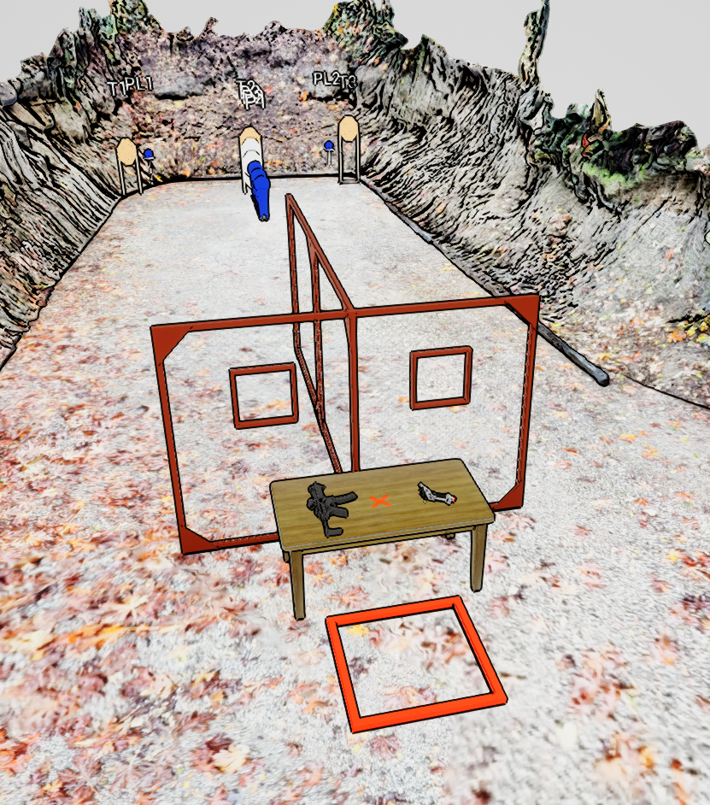
 | Stage 2 Weak Already? Course Designer: Loke Tan

